Slide 1
Pre-registration System
GLORIA, Diego
ROGUEL, Angelica
RUIZ, Angelica

Slide 2
Background of the Problem
In Asia Pacific College (APC):
There are various subjects offered
The units of the subjects depend on its weight and relevance to the student’s course
Those subjects are modifiable depending on different reasons.
The process of modifying subjects is called a pre-registration.
Current Pre-registration system: Manual
FLAVIO system has different registration features such as: Student Flowchart, Online Teachers Evaluation, Online Grades Viewer, Masters List
Advisers are professors assigned to approve pre-registration requests of students.
There are policies that the advisers follow to correctly update the students’ assessment form (ex.: there is a maximum number of units for each student)
Exceptions/Special cases can be made due to case-to-case basis

Slide 3
Statement of the Problem
Which registration system feature/s best serves students in their school?

Slide 4
Objectives
Measure student's satisfaction in their school’s registration system
To find out the impressions of students about their registration system (ex.: convenience, helpful)
Collect results, summarize and come up with conclusion
To understand the flow of the current pre-registration process
To provide convenience to students and advisers
To integrate the online pre-registration database to FLAVIO database
To lessen the processing time of pre-registration by five percent (5%)
To lessen the costs of papers by twenty percent (20%) due to the manual pre-registration

Slide 5
Significance
The proposed Online Pre-registration System can contribute to the APC community.
The aspects looked into are the:
-- convenience of the students
-- the full potential of the school's online services
-- simplified tasks for the current manual process of the system

Slide 6
Scope and Limitations
Data gathered would come from different students from different schools
But, the proposed online pre-registration system would be used solely by the APC community
The FLAVIO website can be accessed outside. In order to access the website, authentication is required (username and password)
Flavio and online pre-registration database will be integrated
Crashing of the website can be examined by the group (because of error in the code) and overloading of the website can be handled by the ITRO staff because they have access in the servers where the databases are located

Slide 7
Related Literature
UP Computerized Registration System
-- Features: Pre-enlistment, pre-registration, registration
La Consolacion College Enrollment System (from projects2wiki)
-- Features: Organized record of the student’s enrollment transactions, enrollment

Slide 8
Event Table

Slide 9
Pre-registration System Event Table
Event | Trigger | Source | Use Case | Response | Destination
1) Registrar creates Subjects and Schedules | Masters List And Flowchart | Registrar | Subjects and schedules creation | Complete Subjects and Schedules | Flavio Database
2) Flavio Database updates Masters List | Update of Masters List | Flavio Database | Update of Masters List | Flavio Database updates Masters List | Registrar
3) Student gets Pre-reg form From Registrar | Modification of subjects | Student | Student gets Pre-reg form From Registrar | Student fills up pre-reg form | Adviser
4) Adviser approves request for modification of subjects (form) | Request for modification of subjects (form) | Student | Approval of Request for Modification of subjects (form) | Adviser approves the request | Assessment Form
5) Adviser updates Assessment Form | Approved Request (form) | Assessment Form | Update of Assessment Form | Assessment Form is updated | FLAVIO Database
6) FLAVIO Database updates Masters List | Assessment form is updated | FLAVIO Database | Update of Masters List | Masters List is updated | Registrar

Slide 10
Pre-registration System Event Table
Event | Trigger | Source | Use Case | Response | Destination
7) Student receives updated Assessment Form | Updated Assessment Form | Registrar | Student receives updated Assessment Form | Student accepts Assessment Form | Student

Slide 11
Diagrams

Slide 12
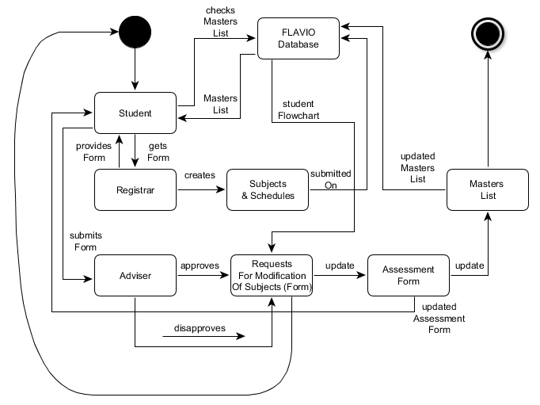
State Machine Diagram

Slide 13
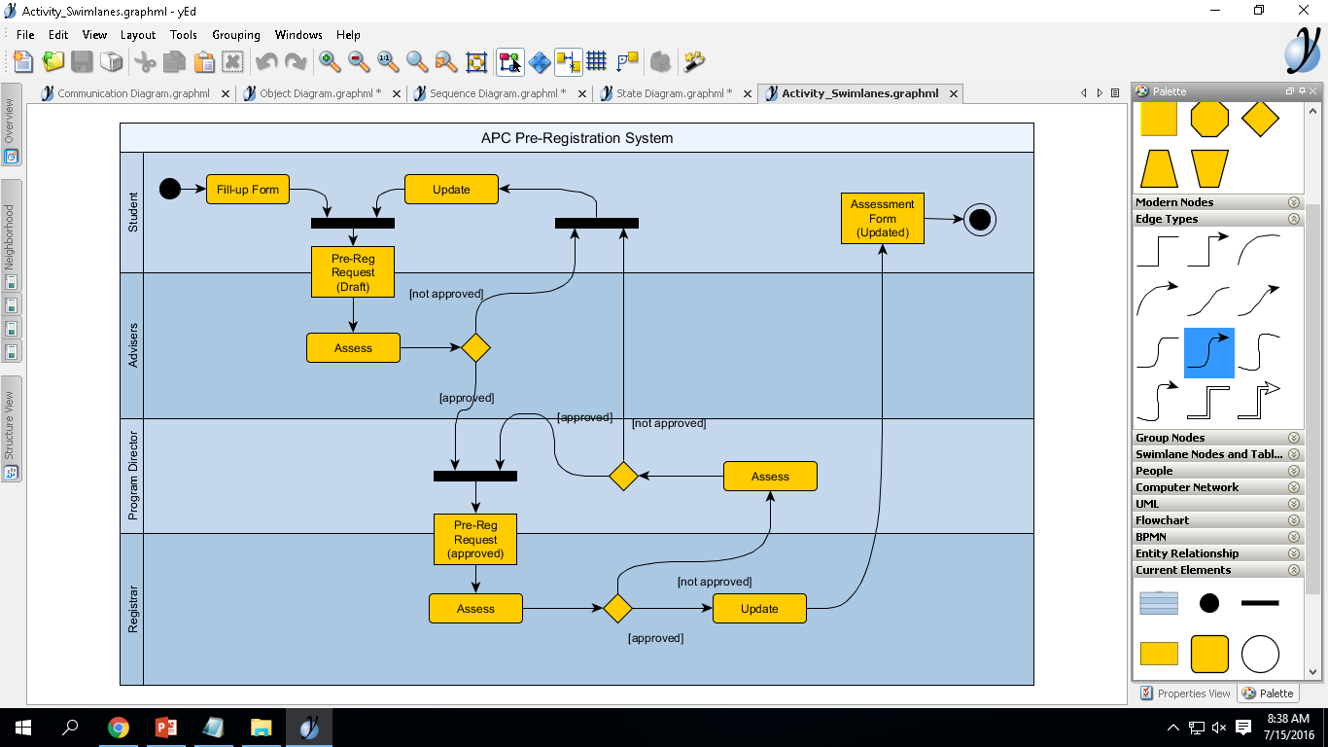
Activity Diagram

Slide 14
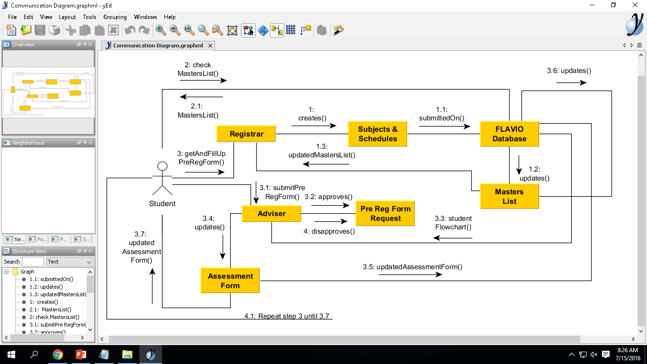
Communication Diagram

Slide 15
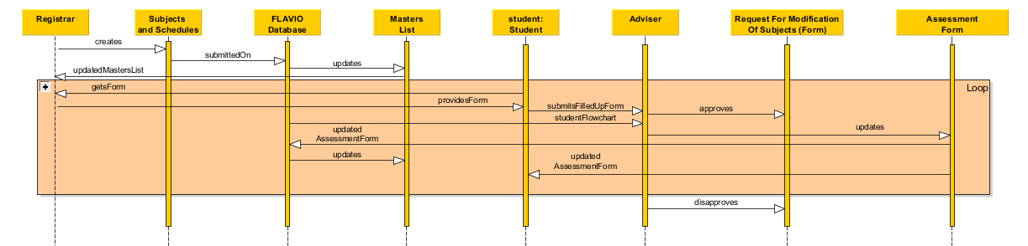
Sequence Diagram

Slide 16
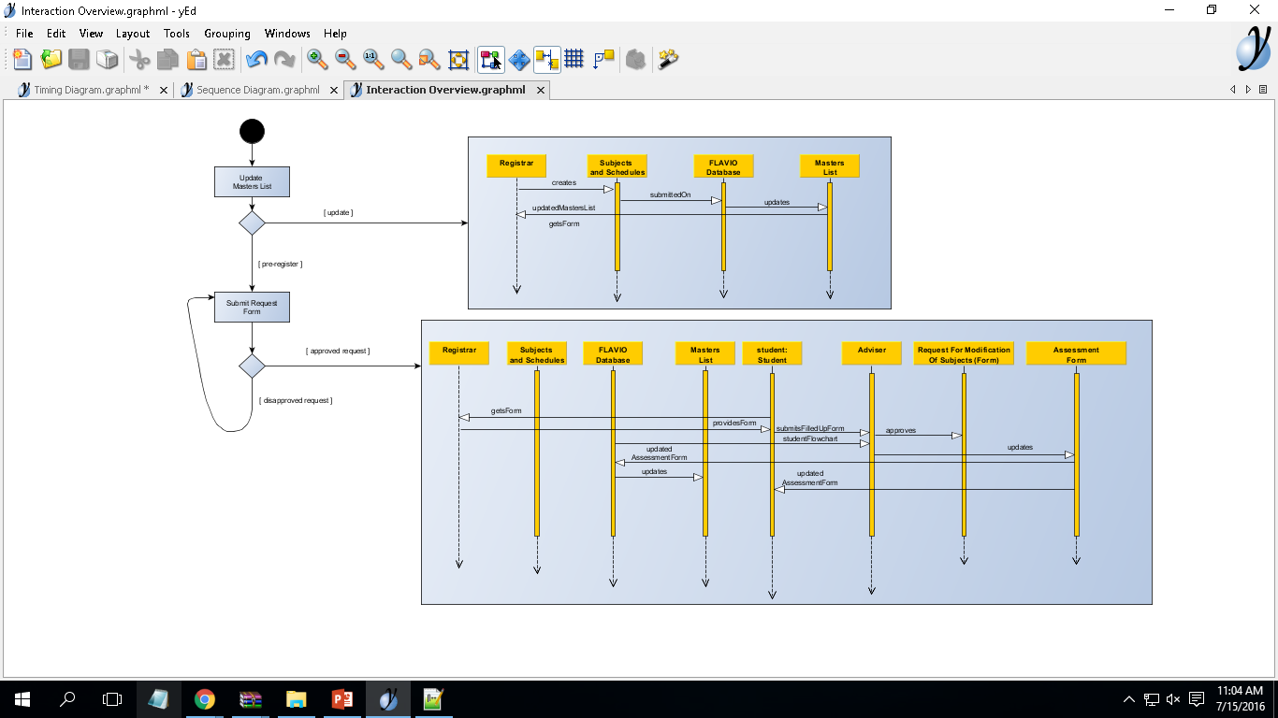
Interaction Overview Diagram

Slide 17
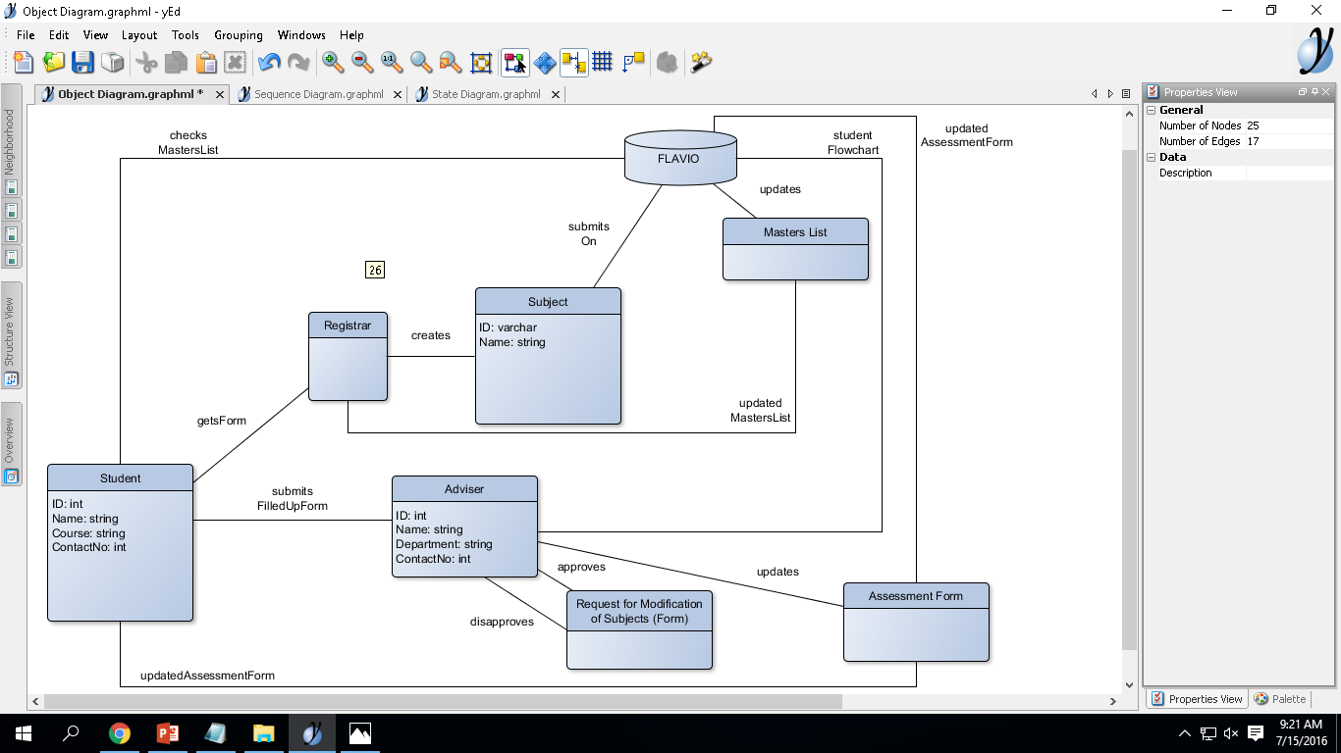
Class Diagram

Slide 18
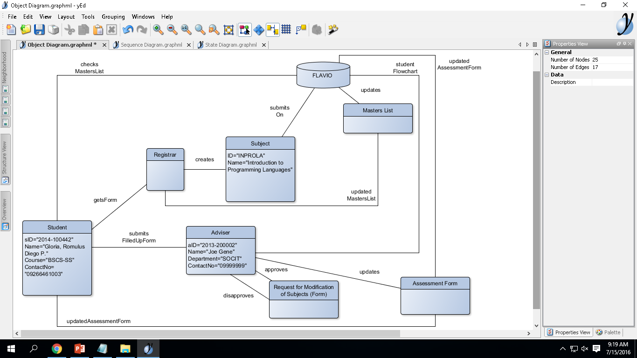
Object Diagram

Slide 19
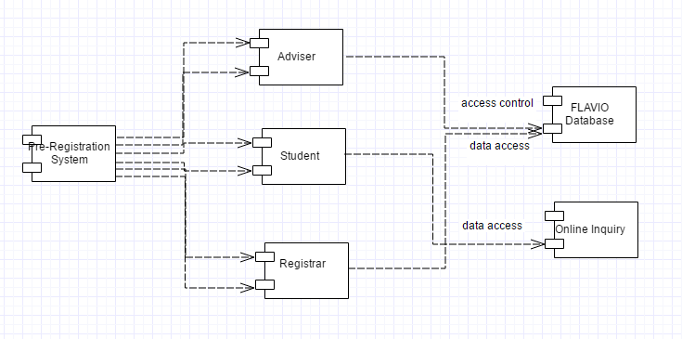
Component Diagram

Slide 20
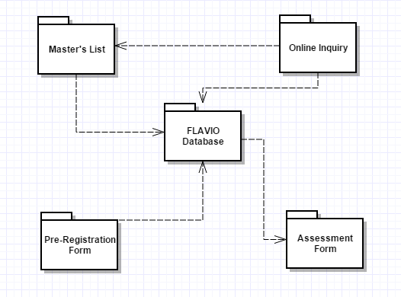
Package Diagram

Slide 21
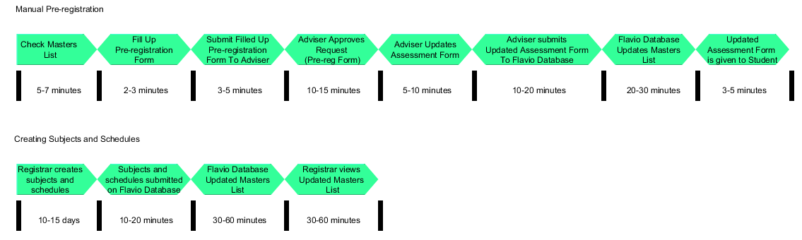
Timing Diagram

Slide 22
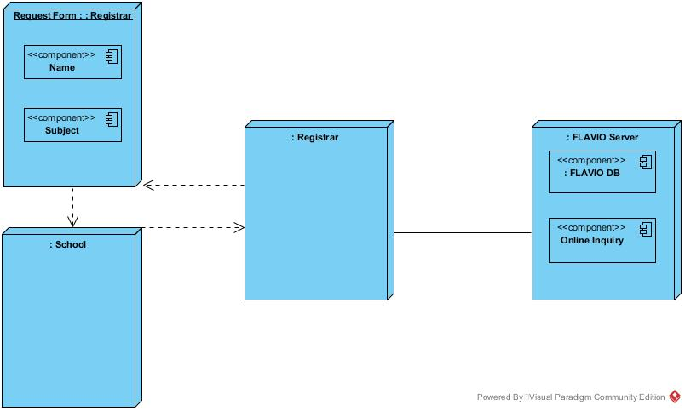
Deployment Diagram

Slide 23
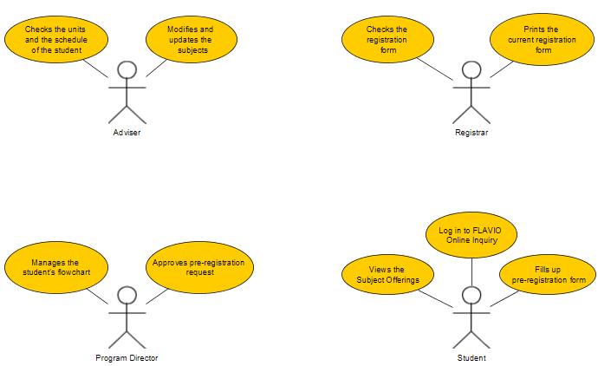
Use Case Diagram

